Slide 1


Slide 2

Dr. Ingrid Pincott ND

Slide 3

Campbell River
Citizens Townhall
Information & Discussions About Provincial Bills
March 26th
Vicki Allenspach
Moderator

Slide 4

Treat others with
kindness
and Consideration

Slide 5

Please
Mute
Your
Phone

Slide 6

This event is
Being
Recorded

Slide 7

For More Information
Community Based
Volunteer Run
Listen, Ask Questions
Get Answers, Take Action
www.BCTownHalls2024.ca

Slide 8




Slide 9

Tonight’s Agenda
7:10 to 8:00
Speakers
8:00 to 9:00
Q & A
9:00 to 9:45
Mingling

Slide 10
Tonight’s Topics
Bill 36 - HPOA
Health Professions
and
Occupations Act
Bill 31
Emergency & Disaster
Management Act
Bills 44, 46, 47
Housing Amendment Acts

Slide 11

Tonight’s Speakers
Dr. Christoph Kind ND
Dr. Anna Kindy MD
Gail Davidson
Write
Questions
And
Get Answers
Dr. Stephen Malthouse MD
John Rustad

Slide 12
Dr. Christoph
Kind ND
Write Your
Questions
And
Get Answers
Bill 36
HPOA ACT

Slide 13
Bill 36/HPOA ACT
HPOA - Heath Professions and
Occupation Act
All licensed health care professionals
Passed Nov 2022
276 pages, 645 clauses
Little consultation
Not fully debated

Slide 14
HPOA ACT
Most public and health care workers still unaware of this ACT.
Unprecedented power to the Minister of Health leading to government overreach in your healthcare.
Future regulations:
              Behind closed doors
              No input from stake holders

Slide 15
Political Interference
Health professionals need to be regulated to protect patients HPOA act is about control and not patient safety.
Amalgamation of 15 colleges
All positions on college boards appointed by Minister of Health
    Previously 50% percent elected (345, 346 486)
Can dismiss and reappoint board members 537(2), 482
No input from the front line health care workers
e.g. Safer supply

Slide 16
Political Interference
Health Minister can override public health and mandate emergency measures including vaccines. 330, 331, 49,(3f)
The Minister of Health may adopt as law regulations and standards from unelected, unaccountable foreign jurisdictions or international bodies. 335(2), 533(1)
Ideology over peer reviewed data
  Vaccine mandates for BC.

Slide 17
Political Interference
343 (2)regulatory college is not an agent of the government
344 (3) Responsibilities of board
(3) A regulatory college, through its board, must ensure that the board and all officers, employees and agents of the regulatory college
    (a) comply with all orders of the minister and the superintendent that apply to the regulatory college,
    (b) cooperate fully with the superintendent in the superintendent's exercise of powers and performance of duties under this Act, and
    (c) meet performance standards that apply to the regulatory college.

Slide 18
Political Interference
345 (2) The minister may reject a recommendation of the superintendent and request a new recommendation if the minister is of the opinion that doing so is necessary

Slide 19
Loss of Personalized Medicine
Loss of privacy – search and seizures without warrant 131, 224,506,511
Misinformation not defined and can lead to fines of $25,000 and 6 months in jail (514, 518)
Loss of informed consent and bodily autonomy
All leads to changes in patient/doctor relationship
Future regulations:
              Behind closed doors
              No input from stake holders
              No quality measures

Slide 20
HPOA ACT
Control over safety
Patients less safe for patients when medicine is politicized.

Slide 21
Ethics in Health Care
Hippocratic Oath: Do No Harm

Slide 22
Gail Davidson
Bill 36
From a Lawyer’s
Perspective
Write Your
Questions
And
Get Answers

Slide 23
Say NO to The Health Professions and Occupations Act of British Columbia
Gail Davidson*
*Interpretations are solely those of Gail Davidson.
Feedback is welcome on errors, omissions, analyses.
22 March 2024

Slide 24
Background
The Health Professions and Occupations Act (Act)
Improperly pushed through on 24 November 2022 without the consultation, disclosure, debate and informed voting required in a democracy.
Perhaps the largest bill ever presented to the BC Legislative Assembly at 645 sections over 276 pages, the Act involves repeal of one and amendments to 33 statutes and concerns the governance, licensing, discipline and control of approximately 130,000 health care workers in 25 health professions and occupations in BC.
Repeals the Health Professions Act (s. 546) and amends 31 existing statutes (ss 547-644).
Has never been subject to proper disclosure, debate and acceptance or rejection by health care workers, the Legislative Assembly or the 5 million residents of BC in need of access to ethical personalized medical care.
Has 645 sections over 276 pages and will replace the Health Professions Act which has 54 Sections over 83 pages.
Is not yet in force.

Slide 25

The Unstated Purpose of the Act
The Act paves the way for global totalitarian control of health care in BC. The Act
allows for adoption as law in BC, regulations, standards, codes or rules enacted in other jurisdictions or set by “any body that may make codes, standards and rules” (ss. 533, 335), which would allow rules set by the WHO, WHA, WEF to become law in BC;
mirrors proposed changes to the International Health Regulations (IHR) that appear to provide the foundation of a global system of control over all aspects of health;
IHR proposed rules grant powers to; (i) change the meaning of words; (ii) mandate or prohibit medical treatment of choice; (iii) collect, use and share personal health information without permission; (iv) mandate treatments; (v) declare international or regional health emergencies in response to actual or potential threats to health; (vi) mandate responses to a declared public health emergency; and, (vii) impose punishments for non-compliance. The IHR allow almost anything to qualify as a public health emergency.
The Act authorizes similar measures without a public health emergency. As stated by US law professor Francis Boyle, the IHR and the Pandemic Treaty “are fatally dangerous. Either one or both would set up a worldwide medical police state under the control of the WHO, and… WHO Director… will be able to issue orders that will go all the way down the pipe to your primary care physicians."

Slide 26

Petition to Recall Premier of BC & Rescind the Act
A Petition to recall Premier David Eby as the MLA for Vancouver Point Grey was initiated because of perceptions that the Act:
Impairs or destroys rights to provide and receive personalized health care;
Puts political appointees in charge of governance and licensing of health care workers, lawmaking regarding health, seizure of health records, definition of ethical standards and the punishment of health care workers;
Prohibits punished medical advice to patients of opinions to public that are not sanctioned by authorities;
Criminalizes freedom of expression and authorizes violation of other essential rights including rights to privacy and due process;
Authorizes adoption as BC law, laws made elsewhere and rules made by organizations without notice, justification, consultation, voting or oversight;
Allows appointees to mandate vaccination as a condition of licensing and employment;
Creates involuntary markets for pharma products through mandated vaccination;
Authorizes appointees to change the meaning of words.
The Petition did not receive the requisite number of signatures to trigger recall.
https://www.bclaws.gov.bc.ca/civix/document/id/complete/statreg/96398_02

Slide 27
Recall Petition & Petition to Legislative Assembly
Recall Process – To trigger recall of MLA David Eby, the Recall and Initiative Act required campaigners to collect, in 60 days ending 17 March 2023), signatures from 40% of the 41,000 voters in the Vancouver Point Grey constituency.
11.31% of constituents voting in the 2022 election opposed the Act and supported Recall - 2,737 Vancouver Point Grey constituents, representing 11.31% of votes cast in the October 2020 election signed the petition to recall the Premier for his support of the Act.
17,500 signed a Petition to the Legislative Assembly of BC opposing the Act. - On 4 May 2023 John Rustad, Leader of the Conservative Party of BC and MLA for Nechako Lakes presented a Petition signed by 17,500 people calling for the Act to be paused.

Slide 28
Issues of Concern: Impact of the Act
  Governance
  Slides 8-12
Page 00
2
1
  Law Making
Slides 11-13
  Compulsory Vaccination
Slide 14
3
  Emergency Orders
Slides 20-21
4
  Enforcement
Slides 20-21
5
  Data Collection
Slides 22-23
6
7
  Immunity & and Limited Review
age 00
  No Statutory Purpose
  Slides 24-25
Page 00
8

Slide 29
Governance
The Act abolishes democratic governance of health care colleges and imposes governance by political appointees.
    Under s. 17 of the existing Health Professional Act, boards are composed of a majority elected by members and people appointed by the Minister of Health (minister). Appointees cannot exceed elected board members.
    Under s. 346 of the Act, all members of the board will be appointed by the minister, half licensees and half “representatives of the public.” (“A regulatory college is a corporation consisting of the persons appointed as members of the board.” (See ss. 343 (1), 344, 345, 346). Appointees are not independent of the Executive and are not required to be competent or impartial.

Slide 30
Governance
The Act empowers the Minister and Cabinet to appoint dozens of people to positions of authority over all aspects of health care without notice to, or consultation with, the public, health care workers or the BC Legislative Assembly.
      The Superintendent of Health Professions and Occupations Oversight (superintendent) is appointed by Cabinet (s. 436 (2) and reports only to the minister (s. 486).
      The Office of the Superintendent is “an arm of the government” (s. 345 (1)) and has significant powers including to make recommendations to the minister on the administration of and amendments to the Act, improvement of performance of regulators and “any other matter the minister requests”; and, to publish any “information and record’ deemed by the superintendent to be in the public interest (s. 345 (2).
      The Director of Discipline is appointed by the minister (s. 444) and then the Director himself appoints the Deputy Director who exercises the same powers of the Director (s. 445). Their wide powers include to: manage discipline panels, set practice directives, issue and cancel disciplinary citations and approve disciplinary orders. For actions regarding disciplinary proceedings they have statutory immunity (s. 400)

Slide 31
Governance
The Act empowers appointees to exercise powers and to themselves appoint dozens of other authorities with duties under the Act.
      Appointed Boards are mandated to:
    Make bylaws regarding: monitoring licensees for contraventions of the Act; complaint procedures; production of records; summary protection orders; summary actions by the registrar (s. 118); anti-discrimination measures; sexual misconduct; what constitutes false or misleading information (s. 70(2);
    Appoint the registrar, professional standards advisors and members of the license, investigation and permit committees (s. 359);
    Seek advice from the professional standards advisors appointed by the board when making bylaws on eligibility, ethics and practice standards (s. 361).

Slide 32
Law Making
The Act authorizes adoption as law in BC, regulations, codes, standards or rules, enacted by “another jurisdictions including a foreign jurisdiction, or set by a provincial, national or international body or any body that may make codes, standards or rules.” (ss. 533 (1), 335 (2))
    Cabinet and an unspecified number of appointees are authorized to adopt as law in BC any regulations, codes, standards or rules enacted in any other jurisdictions or set by any national or international organizations (s. 533 (1));
    A provincial health officer may, when making scope of practice orders (emergency orders), also adopt as law in BC, any regulations, codes, standards of rules enacted in other jurisdictions or set by any national of international body (s. 335).
These provisions would allow the adoption as law in BC, any rules set by, for example, the World Health Organization, World Health Assembly or World Economic Forum.
This would allow adoption of the International Health Regulations and/or the Pandemic Treaty, whether or not Canada voted for or otherwise accepted such provisions.
Adoption can occur without notice, disclosure, justification, consultation, debate or consent and without oversight by the public, health care workers or the Legislative Assembly.

Slide 33
Law Making
The Act creates acts of misconduct and criminal offences that violate the principle of legality and predictability. The offences are not defined with sufficient specificity to be objectively determined in advance of contravention or hearing and therefore cannot be avoided or defended and contravene freedom from ex post facto law.
    Examples of illegitimate offences and acts of misconduct:
  “providing false or misleading information to patients or the public” is both an act of misconduct (s. 70 (2) (g)) and a criminal offence (s. 514(2) (b));
  “conduct that may bring the practice… into disrepute.” Section 11 (2) states, “a licensee commits an act of misconduct if the licensee engages in conduct that (a) may bring the practice of a designated health profession into disrepute”.

Slide 34
Law Making
The Act authorizes appointees to:
  Mandate vaccination for ‘transmissible disease’ as a condition of licensing and employment Sections 49 (1) (b) (v) and 49 (3) (f) respectively provide that boards must and may make bylaws mandating vaccination. It is not clear if boards may make bylaws requiring mandatory vaccination in the absence of “an enactment”. Boards have unrestricted authority to make by-laws “in collaboration with other persons” (s. 67). The Act does not define vaccination or transmissible disease;
  These mandates violate individual rights accept or refuse medical treatment and experimentation and to informed consent and, rights to deliver personalized care.
  Make rules regarding: informed consent (s. 72 (3) (b); ethical standards (ss. 70(2), 361); what health care services can be provided, by who, to whom (s. 72(3), and in what locations (s 72 (4) (a). The Act does not require that rules respecting informed consent conform with rights established by Canadian law and international treaties to which Canada is a State Party (s. 72 (3) (b);

Slide 35
Law Making – Compulsory Vaccination
The minister may mandate vaccination: The minister may make regulations requiring applicants and regulated health service providers to be vaccinated against specified transmissible illnesses (s, 200 (2) (a)).
Boards must mandate vaccination - Boards must make bylaws mandating vaccination against transmissible illnesses as a condition of licensing when there is an enactment requiring vaccination (s. 49 (1)).
Boards may mandate vaccination. Boards may make bylaws mandating vaccination, required under the bylaws, against transmissible illnesses (s. 49 (3) (f)).
The provincial health officer can, as an emergency order, adopt mandatory vaccination requirements set by any state or any non-state organization, anywhere (s. 335 (2)).
Cabinet and an unspecified number of appointees can , in non-emergency time, adopt as law mandatory vaccination requirements enacted by other states or set by non-state organization anywhere (s. 533 (1)).

Slide 36
Law Making – Emergency Orders
The Act (ss. 325-340) authorizes the minister and the provincial health officer to make emergency orders. Whenever notice of a public health emergency is provided under the Public Health Act, the minister can make administrative orders emergency orders (ss.330-331: the provincial health officer can make scope of practice orders emergency orders (ss. 333 – 340).
Emergency Orders are not required to be lawful, necessary, proportionate, legitimate or temporary. The Act does not require that emergency orders comply with Canadian or international law obligations to maintain rights, democracy and the rule of law.

Slide 37
Law Making – Emergency Orders
Public health emergency powers
Broad Interpretation -The Act allows a broad interpretation of a public health emergency (see s. 325 and Public Health Act s. 52(2)) and authorizes emergency orders without notice and information needed to assess justification and without consultation with health care professionals, emergency specialists, the Legislative Assembly or other informed parties.
Competence to make orders not required - Neither the minister or the provincial health officer are required to have the competence to assess the lawfulness, necessity, legitimacy or proportionality of emergency orders or to identify measures capable of delivering benefit, limiting harm and complying with domestic and international law.
Additional Risks of Emergency Powers–through summarily imposed laws, mandates, restriction and prohibitions to rights to provide and receive personal health care.

Slide 38
Law Making – Emergency Orders
The Act authorizes the minister and the provincial health officer to summarily make undemocratic, apparently unreviewable and potentially dangerous emergency orders:
  Based on subjective determinations of necessity and harm (ss. 330, 333) and on subjective opinions of appropriateness (s.335 (2) (a));
  Made without release or debate of the information needed to assess the safety, efficacy necessity, proportionality or legitimacy of the emergency orders;
  Restricted to one or more persons, classes of persons or geographical areas (s. 327(2).
  Made without notice to or oversight by, MLAs, the public or the affected health professions, occupations or patients (s. 326 to 329).

Slide 39
Law Making - Emergency Orders
4. (cont’d) The Act authorizes imposition of emergency orders:
  Made without notice, other than to appointees who lack independence and possibly the competence or impartiality (ss. 326 to 329) to act in the public interest;
      Before making an emergency order, the minister and provincial health officer must give notice to and make reasonable efforts to consult: the superintendent, the Health Professions Review Board and affected regulators (s. 329(a), all of whom are appointees;
      The provincial health officer must give notice to the minister and advise of any objections raised by the above named appointees (s. 329(b);
  Based on any regulation, code, standard or rule, enacted in any other jurisdiction or “set by a provincial, national or international body or any other body that may make codes, standards or rules, or published by a laboratory…” (s. 335(2), adopted by the provincial health officer.

Slide 40
Law Making – Emergency Orders
5. The Act (s. 335) authorizes the provincial health officer to adopt as law in BC, laws enacted in any other jurisdiction and rules adopted by any state or non-state body anywhere:
    in the sole discretion of the provincial health officer;
    if adoption is “appropriate,” in the personal, subjective opinion of the provincial health officer;
    with no requirement that the rules adopted as law serve a public purpose or be consistent with domestic or international law obligations or the rule of law;
    without any notice to, consultation with, debate by or consensus of the Legislative Assembly, the public, health practitioners and without evidence justifying adoption;
Section 335 would, for example, allow adoption all or some of the International Health Regulations as law in BC, including measures restricting guaranteed rights.

Slide 41
Enforcement
The Act imposes severe penalties for acts of misconduct that include temporary or permanent loss of licenses and employment and for criminal offences, fines up to $500,000, imprisonment up to 2 years (s. 518) and additional penalties for each day that the offence continues (517).
The Act authorizes “the minister, a board or a health occupation director” to establish all medical and ethical standards along with standards governing eligibility to practice and accreditation (s. 7 (1)).
The Act imposes a mandatory duty on licensees to report other licensees believed to be “not fit to practice” or to present “a significant risk of harm to the public“ (s, 85).

Slide 42
Enforcement
The Act authorizes appointees to suspend the license to practice without notice to the practitioner and before a complaint has been investigated or determined.
  A registrar can make suspend a practice license by summary protection order (SPO) before a complaint is referred to an investigation committee (ss. 122 (1) and 153);
  A health occupation director can also make SPOs (s. 225);
  Section 259 authorizes SPOs when, inter alia, “a respondent is providing false or misleading information to patients or the public” What constitutes false and misleading information is not defined.
    The SPO can be issued without notice or hearing (s. 260). Regarding the arbitrariness of the term ‘misleading’, see US District Court decision of 25/01/23 granting an interim injunction against enforcement of provisions allowing discipline of doctors for spreading misinformation.

Slide 43
Data Collection and Control
The Act allows invasion of patient and professional privacy. The Act allows the collection, use and disclosure of confidential information even “…for purposes…not covered by the Act” (s. 530). This section allows an order for the collection, use and disclosure of personal information excluded from disclosure by ss. 491 and 492.
The Act allows the search of premises and seizure of documents including patient records with and without a warrant. The Act contemplates applying for court orders exparte and in secret (ss. 502(1), 503 (1)) authorizes seizure of documents not described in a court order (s. 508) and authorizes, without a warrant, securement of practitioner’s premises, search and seize documents (s. 511) and treatment of items seized as though there had been a court order.

Slide 44
Data Collection and Control
The Act authorizes appointees to order the production, examination and copying of documents and confidential records.
An investigator may order production of information and without a court order, may enter premises and inspect and copy documents (s. 131);
  The superintendent may order production of documents or enter premises without a warrant and inspect and copy documents (s. 469(1));
  The Health Occupation Director may make complaints (s. 222) and order production of information including confidential information (s. 224);
  The provincial health officer may make an emergency order for the production of records to the minister and appointees (s. 338) and such orders last for 90 days after “the order ceases to have effect” (s. 328 (4)).
    These provisions potentially authorize violation of the privacy rights of patients and practitioners without prior notice or hearing.

Slide 45
Lack of Legitimate Statutory Purpose
The Act appears directed at restricting, not enabling the quality, provision, delivery and receipt of individualized health care ostensibly to prevent harms posed by members of health professions and occupations.
  Section 6 defines health professionals as providing services that “present a risk of harm to the public”: those practicing health occupations are described as providing health services that “present a lower risk of harm to the public”, and,
  States that regulation of health professionals is necessary and regulation of health occupations advisable in order to protect “the public from harm” and “the public interest” (s.6). Neither harm or public interest is defined.
    Although health professionals must act ethically, safely, and in accordance with applicable ethics and practice standards, the definition of these standards is left to be determined, perhaps arbitrarily, by appointees (see s. 7(2) definition) who may lack competence.

Slide 46
Lack of Legitimate Statutory Purpose
The Act does not mandate licensees to serve the medical needs of individual patients.
Instead, the Act mandates licensees to:
    to protect the public from harm and discrimination;
    to take anti-discrimination measures; and,
    to act in a manner that is respectful of the privacy of patients. (72 (1)):
    The Act does not require licensees to respect the paramount duty of health professionals to ensure patient rights to informed consent (or refusal) to medical treatment, freedom from coercion or force to accept treatment not voluntarily chosen and freedom from non-consensual medical or scientific experimentation.

Slide 47
Immunity and Limitation of Review
The Act limits review by any court of some decisions and orders made by appointees.
    The Act grants exclusive jurisdiction to inquire into, hear and determine all questions of fact, law and discretion under the Act to the: health occupation director, director of discipline, discipline panel and Health Professions Review Board. Decisions are “final and conclusive and not open to question or review in any court.”(s. 512).
    The Act authorizes the appointment of these decision makers as follows:
    A health occupation director can be appointed by a board or can be a civil servant (ss. 365, 26(2) (ii) (ii)).
    The director of discipline is established by the superintendent’s office (s. 443).
    Discipline panel members are appointed by the Director of Discipline (ss. 169, 449).
    The Health Professions Review Board chair and members are appointed by Cabinet (s. 309).

Slide 48
Immunity and Limitation of Review
Decision-making powers of appointees whose decisions are subject only to limited review include authorizations for:
    A health occupation director to determine misconduct complaints and impose discipline (ss. 230 to 232), and, to make bylaws or rules “in addition to any imposed under this Act” (s. 530(a) (ii);
    The Discipline panel to conduct and set rules for disciplinary proceedings (ss. 173 to 189);
    The Director of Discipline to issue citations and appoint discipline panels (ss. 161 to 170);
    The Health Professions Review Board to conduct reviews (ss. 310 fllg), make orders (s. 319) and make recommendation to the superintendent on policies, discipline processes and investigations.
    An amendment to s. 33 the Pharmacy Operations and Drug Scheduling Act provides immunity from legal proceedings for damages arising from acts done or omitted “(a) in the exercise or intended exercise of a power under this Act, or (b) in the performance or intended performance of a duty under this Act” (s, 629).

Slide 49
Immunity and Limitation of Review
The Act grants immunity from legal proceedings for damages against:
  A regulatory college for anything done or omitted with respect to an investigative or disciplinary action (s. 89);
  Appointees designated as “protected persons” in the exercise of intended exercise of powers or duties under the Act (s.399);
  A “protected person” for conducting an investigation, talking disciplinary action or participating in a disciplinary proceeding (s. 400)
Limited Review On judicial review, the court:
  Must consider the decision maker an “expert tribunal in relation to all matters over which it has exclusive jurisdiction” and,
  Cannot set aside a finding of fact unless there is no evidence to support the finding or the finding is otherwise unreasonable; and,
  Cannot set aside a discretionary decision unless it is patently unreasonable (s. 512, Administrative Tribunals Act s. 58).

Slide 50
Conclusions: Endangers Health Care, Rights & Democracy
The Act is dangerous to health care, rights and democracy and must to be repealed.
The Act is replete with unlawful provisions that restrict and potentially extinguish many essential rights and signals the end of the rights of health care workers to provide without fear of punishment, and patients to receive, personalized health care.
The Act appears to be a trial statute to bypass democratic processes that protect rights and prevent undemocratic or tyrannical law making and control. The Act allows Cabinet, the minister and dozens of unelected, unaccountable political appointees to adopt, create, change and enforce laws that violate rights without notice, justification, access to information, consultation, debate, consensus or oversight by the Legislative Assembly or the public and without meaningful access to effective remedies for victims of rights violations. Rights violated include rights to: equality and non-discrimination, privacy , informed consent, freedom from experimentation, expression, freedom from ex post facto laws, work and participation in decision making
The Act paves the way for BC to partner with big Pharma and other entities (instead of with health care providers or BC residents), unhampered by what Canada has called “the regulatory irritants and roadblocks” of democracy.
Presently the people of BC use pharma: the Act enables Pharma and other non-state actors--with the aid of state powers--to use the people.
The Act does not serve the public interest in ensuring equal access to competent and timely personalized health care in BC.

Slide 51
Dr. Anna Kindy MD
Bill 36
Safer Drug Supply
Write Your
Questions
And
Get Answers

Slide 52
Health Care in Crisis
Campbell Hospital -2017
150% capacity
Nursing Shortage
Access to GP
Wait times increasing

Slide 53
Culture of Fear
Presently, under the system of centralization of healthcare with the health authorities, a culture
of fear already exists
Whistle Blower protection is not being implemented
HPOA Act will increase this culture of fear
Lead to increase healthcare worker burnout
Lead to exit of healthcare workers from BC
Lead to increase patient care decline

Slide 54
Write down
Your questions on
Bill 36

Slide 55
Dr. Stephen Malthouse MD
Write
Questions
You
Want Answered
Bill 31
Emergency & Disasters
Management Act

Slide 56
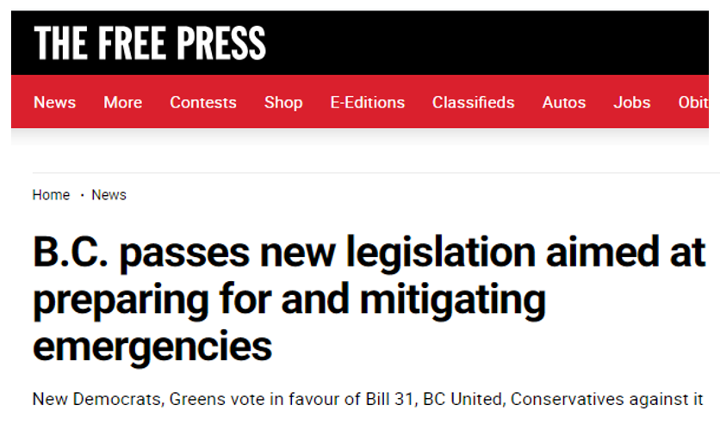

Slide 57
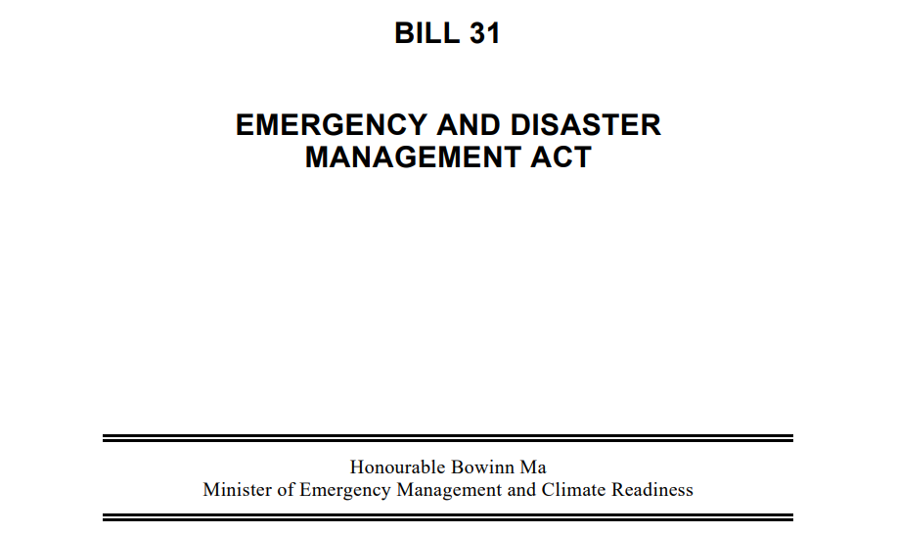

Slide 58
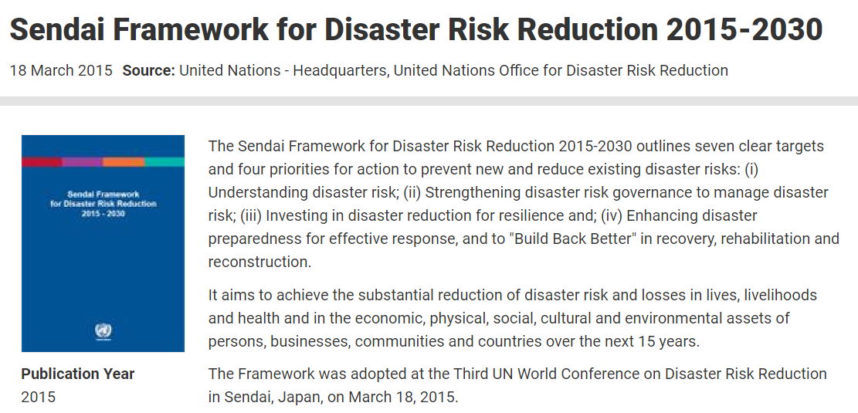
“Build Back Better”
...adopted by the Third UN World Conference on Disaster Risk Reduction…

Slide 59
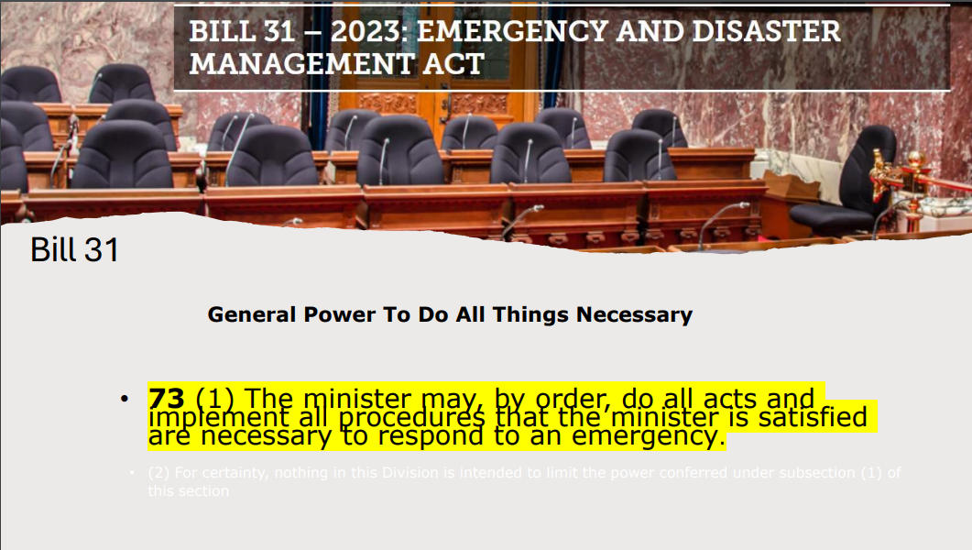
Updates the formal definition of “emergency,”
which now includes transmissible disease, environmental toxins, security threats, and terrorist activities, on top of existing provisions
Why?
“streamline”… “modernize” … “clarify”…

Slide 60
Requires regulated parties (including for critical infrastructure owners) to consult and cooperate with Indigenous governing bodies
Requires risk assessments specific to the effects of climate change
Adds reporting requirements, including for critical infrastructure owners
Adds compliance, enforcement, and cost recovery provisions, including the imposing of penalties for non-compliance
Updates the formal definition of “emergency,”
which now includes transmissible disease, environmental toxins, security threats, and terrorist activities, on top of existing provisions

Slide 61
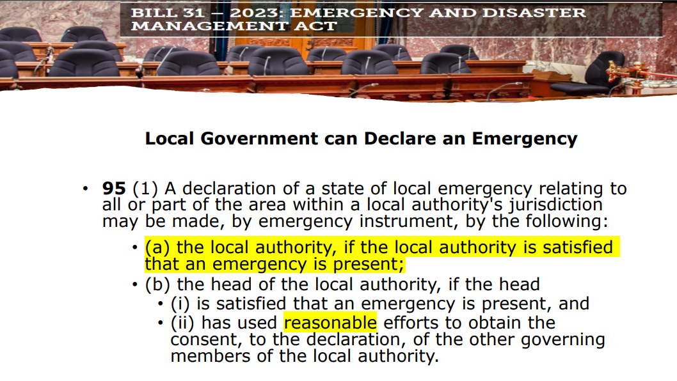

Local Government can Declare an Emergency
95 (1) A declaration of a state of local emergency relating to all or part of the area within a local authority’s jurisdiction may be made, by emergency instrument, by the following:
(a) the local authority, if the local authority is satisfied that an emergency is present;
…
(ii) has used reasonable efforts to obtain the consent, to the declaration, of the other governing members of the local authority.

Slide 62
Directed Mitigation and Preparation Measures
56 (1) The minister may make an order under this section if the minister is satisfied that, based on one or more risk assessments, the order is necessary for any of the following purposes:
(a) to mitigate a specific hazard that presents a significant risk of giving rise to an emergency;
(b) to prepare for a specific type of hazard that presents a significant risk of becoming an emergency;
(c) to support a specific initiative in relation to the mitigation and preparation phases.
73 (1) The minister may, by order, do all acts and implement all procedures that the minister is satisfied are necessary to respond to an emergency.

Slide 63
73 (1) The minister may, by order, do all acts and implement all procedures that the minister is satisfied are necessary to respond to an emergency.

Slide 64
General Restrictions
78 (1) The minister may, by order, control or prohibit one or more of the following:
    travel to and from an area
(b) the carrying on of a business or type of business
(c) an event or type of event
73 (1) The minister may, by order, do all acts and implement all procedures that the minister is satisfied are necessary to respond to an emergency.

Slide 65
Land and Property can be Altered and Destroyed
76 (1) the Minister may, by order, to one or more of the following:
    (a) appropriate, use or control the use of any personal property;
    (b) use or control the use of any land;
    (c) authorize the entry without warrant into any structure or onto any land by any person for the purpose of taking emergency measures;
    (d) prohibit the entry into any structure or onto any land by any person;
    (e) authorize or require the alteration, removal or demolition of any trees, crops, structures or landscapes;
General Restrictions
78 (1) The minister may, by order, control or prohibit one or more of the following:
    travel to and from an area
(b) the carrying on of a business of type of business
(c) an event or type of event
Offences
150 (2) A person who does any of the following commits an offence:
(a) contravenes an order made under section 56
(d) interferes with or obstructs, in the exercise of a power, the performance of a duty or the taking of an emergency measure by a person who is a protected person within the meaning of section 154 or a peace officer.
73 (1) The minister may, by order, do all acts and implement all procedures that the minister is satisfied are necessary to respond to an emergency.

Slide 66
General Restrictions
78 (1) The minister may, by order, control or prohibit one or more of the following:
    travel to and from an area
(b) the carrying on of a business of type of business
(c) an event or type of event
Offences
150 (2) A person who does any of the following commits an offence:
(a) contravenes an order made under section 56
(d) interferes with or obstructs, in the exercise of a power, the performance of a duty or the taking of an emergency measure by a person who is a protected person within the meaning of section 154 or a peace officer.
73 (1) The minister may, by order, do all acts and implement all procedures that the minister is satisfied are necessary to respond to an emergency.

Slide 67
Penalties
153 (1) If an individual commits an offence under this Act, the individual is liable to one or both of the following:
(a) imprisonment for a term of not more than one year;
(b) a fine of not more than $100 000.
(2) If a corporation commits and offence under this Act,
(a) the corporation is liable to a fine of not more than $1 000 000, and
(b) an officer, director, employee or agent of the corporation who directed, authorized, permitted, participated or acquiesced in the offence is liable to one or both of the following:
(i) imprisonment for a term of not more than one year;
(ii) a fine of not more than $300 000.
General Restrictions
78 (1) The minister may, by order, control or prohibit one or more of the following:
    travel to and from an area
(b) the carrying on of a business of type of business
(c) an event or type of event
73 (1) The minister may, by order, do all acts and implement all procedures that the minister is satisfied are necessary to respond to an emergency.

Slide 68
What Bill 31 could really mean...
An arbitrary decision by a politician in the form of declaring an “Emergency” …
… will allow the government to take what it wants from you and your family and, if you resist in any way, you will be punished.
73 (1) The minister may, by order, do all acts and implement all procedures that the minister is satisfied are necessary to respond to an emergency.

Slide 69

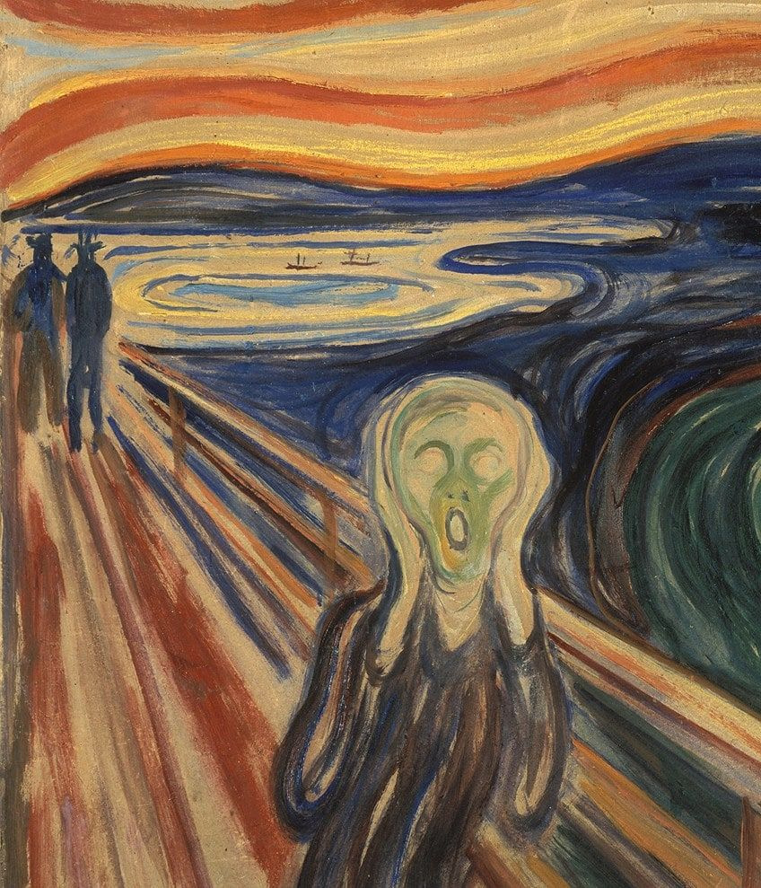




NO HOME & ALONE

Slide 70
John Rustad
BILLS 44, 46 & 47
HOUSING
AMENDMENT
ACTS
Write
Questions
You
Want Answered

Slide 71
BILLS 44, 46 AND 47
HOUSING AMENDMENT ACTS
- in November 2023, the BC NDP swiftly advanced three pivotal bills” Bill 44, 46 and 47.
These legislative measures marked a significant transfer of local powers to the province, superseding established Official Community Plans (OCP). - public input was eradicated, minimum building heights were mandated, maximum density was enforced, and strata powers dictating occupants were rescinded.

Slide 72
2) - Eliminates public participation in community planning, which takes authority away from property owners and municipalities. - neighbourhoods and high-transit areas will favour high-rises and multi-family homes.

Slide 73
3) - These Bills mandate municipalities to endorse three to four units on a single-family lot, circumventing public hearings. - these Bills eliminate almost all parking requirements – the minimum parking requirements for off-street parking currently applicable to six-unit lots will be eradicated, enabling the construction of high-density buildings with zero parking.

Slide 74
4) The Province now determines minimum height requirements, stripping local governments of power to set maximum height requirements. This agenda raises concerns about the future landscape of housing, affordability and community well-being.

Slide 75

Finish Your Questions
And Hold Them Up to
Be Collected
Stand
And
Stretch

Slide 76

Ask Questions
Get Answers
Any Questions That Don’t
Get Answered…….
townhallcr@gmail.com

Slide 77

Listen
Ask Questions
Get Answers
Take Action

Slide 78


Slide 79

Your Vote
Is
Your Voice

Slide 80
Learn more about Canada’s politicians
View Their Scorecard
FPPledge is a citizen run, volunteer organization

Slide 81
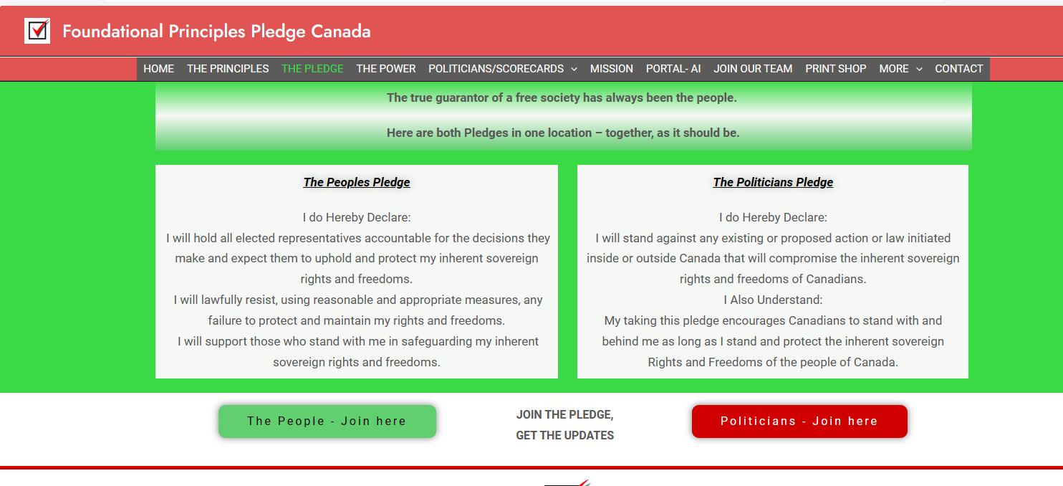
www.fppledge.ca

Slide 82
AND…
Share The Information with
As Many People
As You Can

Slide 83



Slide 84
Please Consider:
Helping Us Financially
E-transfers accepted at:
townhallcr@gmail.com

Slide 85
Future Townhalls to watch for…..
Saturday April 20th
^{2:30-5:30pm}
248 Ingram St.
Duncan
Nanaimo
Courtenay
Updated Info at
BCTownhall2024.ca
LISTEN,
ASK QUESTIONS,
GET ANSWERS,
TAKE ACTION

Slide 86

Dr. Ingrid Pincott ND
(Retired)

Slide 87
Community Based
Volunteer Run
Thank You
For Attending

